Slide 1
Business environment backround
•inhabitants 3248 (~12 000 speaks seto language)
•463 km2
•Dencity 7,3 inhabitants per km2
•303 enterpreneurs- approx 1/3 in tourism
•Seasonality
•Small scale
•Far from cities- Tallinn 300 km, Tartu 100 km

Slide 2
Setomaa as a travel destination
Based on experience
85% Estonian visitors
Foreign visitors from neighbouring countries- Latvia
Growing markets- Finland, Japan
Germany (nature)
Seto village belt- for tourism enterpreneurs https://maps.visitsetomaa.ee/et/kaardid/seto-kylavyy

Slide 3
Key words
Culture- leelo, music
Handycraft
jewllery
Estonian „aborogens“- living traditions
Wellness- mineral water, mud
Food- the biggest organic food % in Estonia
Nature- no factories or production
Contrast- 2 countries (Estonia and Russia), kingdom, own language, own money ect

Slide 4
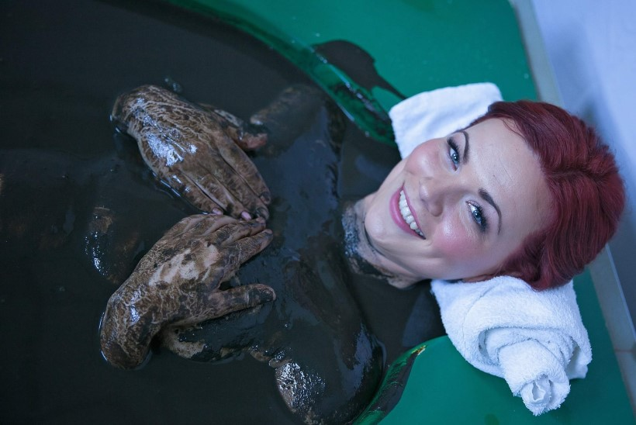
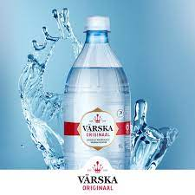
Setomaa is known for- nature
Health resort area
Mineral water
Mineral mud
Pine forests
Rich in berries and mushrooms
Known as Kingdom of chanterelles
RMK long distance trail
Foresttrail trail

Slide 5
Statistics

Slide 6
North camp 3D model
The Northern Camp was founded on the shores of Lake Õrsava in 1926. It was a summer training center for Estonian Defense Forces, mostly for cavalry and artillery. Soldiers gathered here from all over Estonia. The camp buildings included houses for the officers, horse stables, barracks for the soldiers, a Casino or a Soldiers
3D model
Casino
Shooting range
Artillery camp

Slide 7
Audio guide, information stand
16 objects
Navicup
Maps.visitsetomaa.ee maps.visitsetomaa.com
Setomaa Muuseumid www.setomuuseum.ee

Slide 8
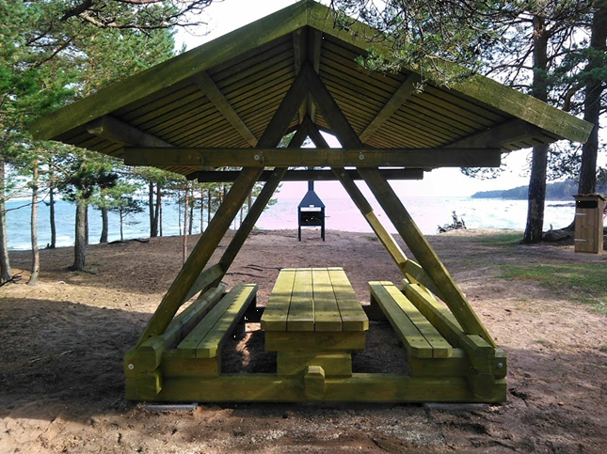
Resting places along the road
Resting places
Bences
Picnic places

